Slide 1

EVON Research Proposal
Predicting Electric Vehicle Registrations in Ontario by Region
Team Members: Hariharasudhan Giridharan, Geoff Krause, Ye Wang, Xuelian Xi

Slide 2

Introduction
01
Background
EV can address environmental concerns and promote sustainable transportation.
02
Objective
Leverage insights to develop a robust predictive model that can accurately forecast EV adoption trends based on demographic and population statistics.
03
Expected Results
The model's predictions can guide businesses in aligning their services with the anticipated demand, thus facilitating a smoother transition towards a sustainable transportation future.
1

Slide 3

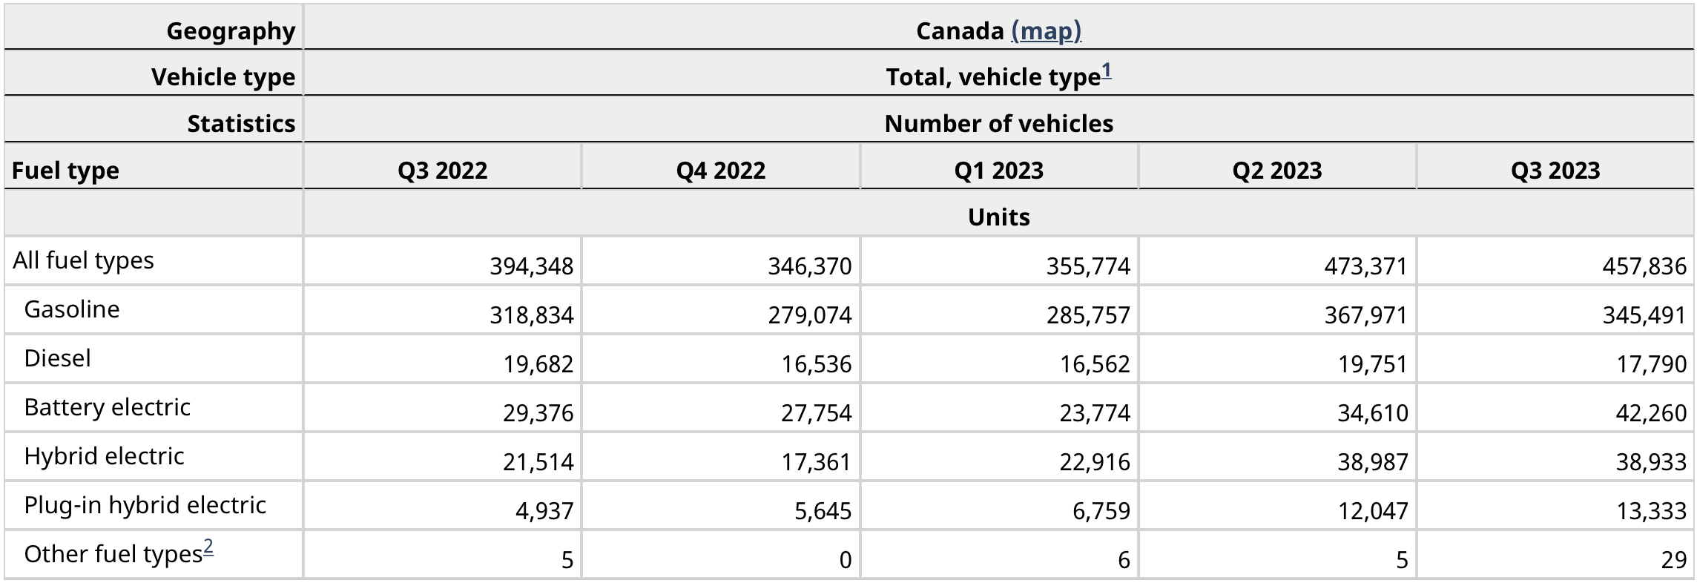
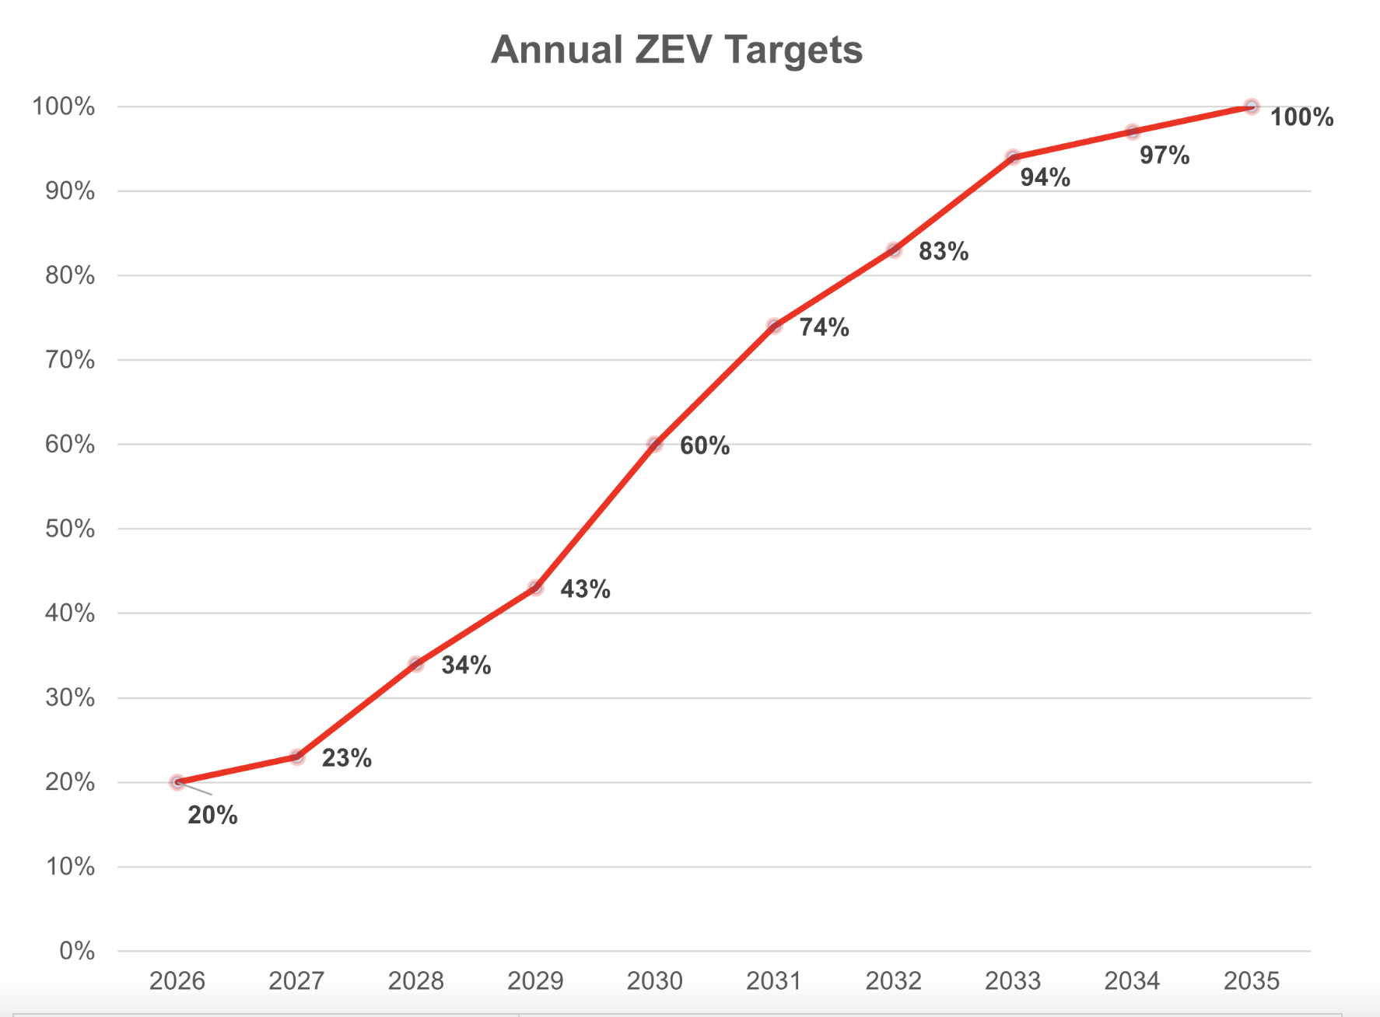
Year 2023 Q1-Q3 :
1,286,951
100,644
Registered Vehicles
BEV (Battery Electric)
7.81%
Proportion
Source: Statistics Canada. Table 20-10-0024-01 New motor vehicle registrations, quarterly
20%
Year 2026 :
Proportion
ZEV: battery-electric vehicles (BEVs) fueled only with electricity
100%
Year 2035 :
Proportion
Source: Government of Canada. Canada’s Electric Vehicle Availability Standard (regulated targets for zero-emission vehicles)
2
Notes:
Huge market in Canada !!!!!

Slide 4
Data Overview
Introduction
TARGET VARIABLE
OBSERVATION
The number of registered electric vehicles (EVs) in areas within the province of Ontario.
Regional characteristics and population details
T
O
TARGET DATASET
OBSERVATION DATASET
Electric Vehicles in Ontario – By Forward Sortation Area - Q4 2023 dataset, produced by the Ontario Ministry of Transportation.
2021 Census Profile dataset
Main mode of commuting from Statistics Canada
3

Slide 5
Data Details
Dataset | Number of Instances x Variables | Variable & Data Types | Source | Release / Validate Date | URL
Electric Vehicles | 550 areas x 4 columns | FSA (region identifier), count of EV registrations (numeric/continuous target var.), Battery/Hybrid breakdowns | Open Government Licence – Ontario | 2023-03-31 (V) [quarterly updates] | https://data.ontario.ca/dataset/electric-vehicles-in-ontario-by-forward-sortation-area
Census Profile | 550 areas x 2,631 characteristics (x total & gender breakdowns) | Variables of interest are numeric/continuous, mix of raw & derived | Statistics Canada | 2023-11-15 | https://www23.statcan.gc.ca/imdb/p2SV.pl?Function=getSurvey&SDDS=3901
Main mode of commuting | (41 or N) areas x 11 commuting types x 7 variables | 5 raw commuting duration values, 2 aggregate values (all numeric/continuous) | Statistics Canada | 2022-11-30 (R) | https://www150.statcan.gc.ca/t1/tbl1/en/tv.action?pid=9810045801
Domains & Features
Location: Region, Latitude
Population: size and density
People Characteristics: age, income, housing, employment, and education
Commuting: times and modes
Regression
Model
4

Slide 6
Functionality
Possible Models:
1. Multivariable linear regression
2. Decision tree regression
3. Random forest regression
Possible Measures:
1. Feature engineering
2. Cross-validation
3. Hyperparameters tuning
Minimum
Expected
Bonus
Data Processing and Cleaning
Multivariate Regression Analysis
Advanced Prediction Techniques
Descriptive Statistics Analysis
Correlation Analysis
Factor Importance Analysis
Preliminary Trend Analysis
Model Evaluation
Geospatial Analysis
Basic Insights
Prediction Model
Optimized Model
5

Slide 7
Project Organization
Evaluation
&
Optimization
Data Processing
Statistical Analysis
Predictive Modeling
Responsible for collecting data from various sources and cleaning, integrating and formatting them.
Realize descriptive statistical analysis and correlation analysis to provide the basis for in-depth analysis.
Develop and optimize multivariate regression models to predict EV registration.
Evaluates the performance of the model and makes necessary adjustments and optimizations to improve prediction accuracy.
01
02
03
04
6

Slide 8
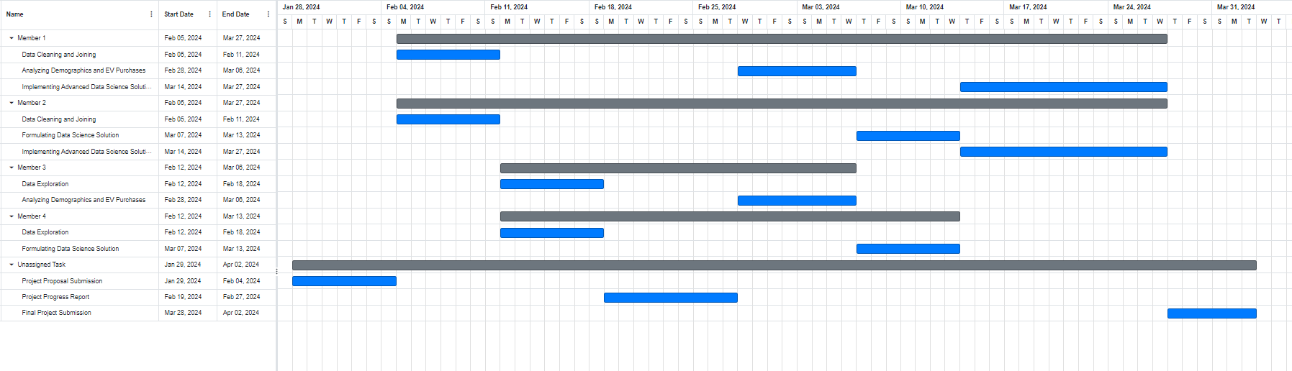
Project Timeline
7

Slide 9
Thank You！

